Slide 1
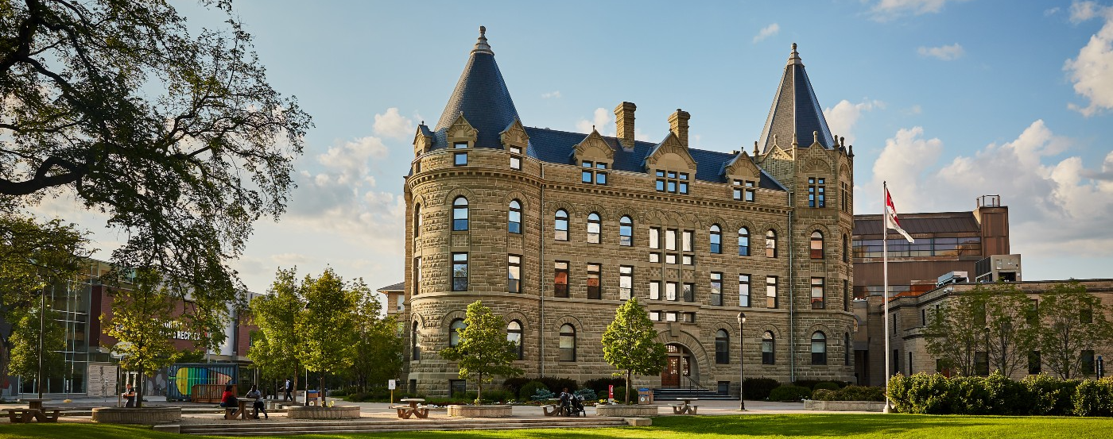
Writing Centre

Slide 2
At the Writing Centre, we can help you
become a better writer!
We offer sessions for students of all years and all writing-based assignments.
Sessions can be in-person at the Writing Centre on the 3rd floor of Graham Hall (3G10) or online.
Sessions are usually an hour, but you can request for up to two hours if needed.

Slide 3
What we do
We can help with things like…
grammar
paragraph structure
argument development/thesis statements
idea organization
understanding of the assignment rubric
And much more!
We can also help you identify problem areas in your own writing and good editing strategies overall, which can make you a more confident writer!
We DON’T proofread/edit your paper, nor do we promise a good grade.

Slide 4
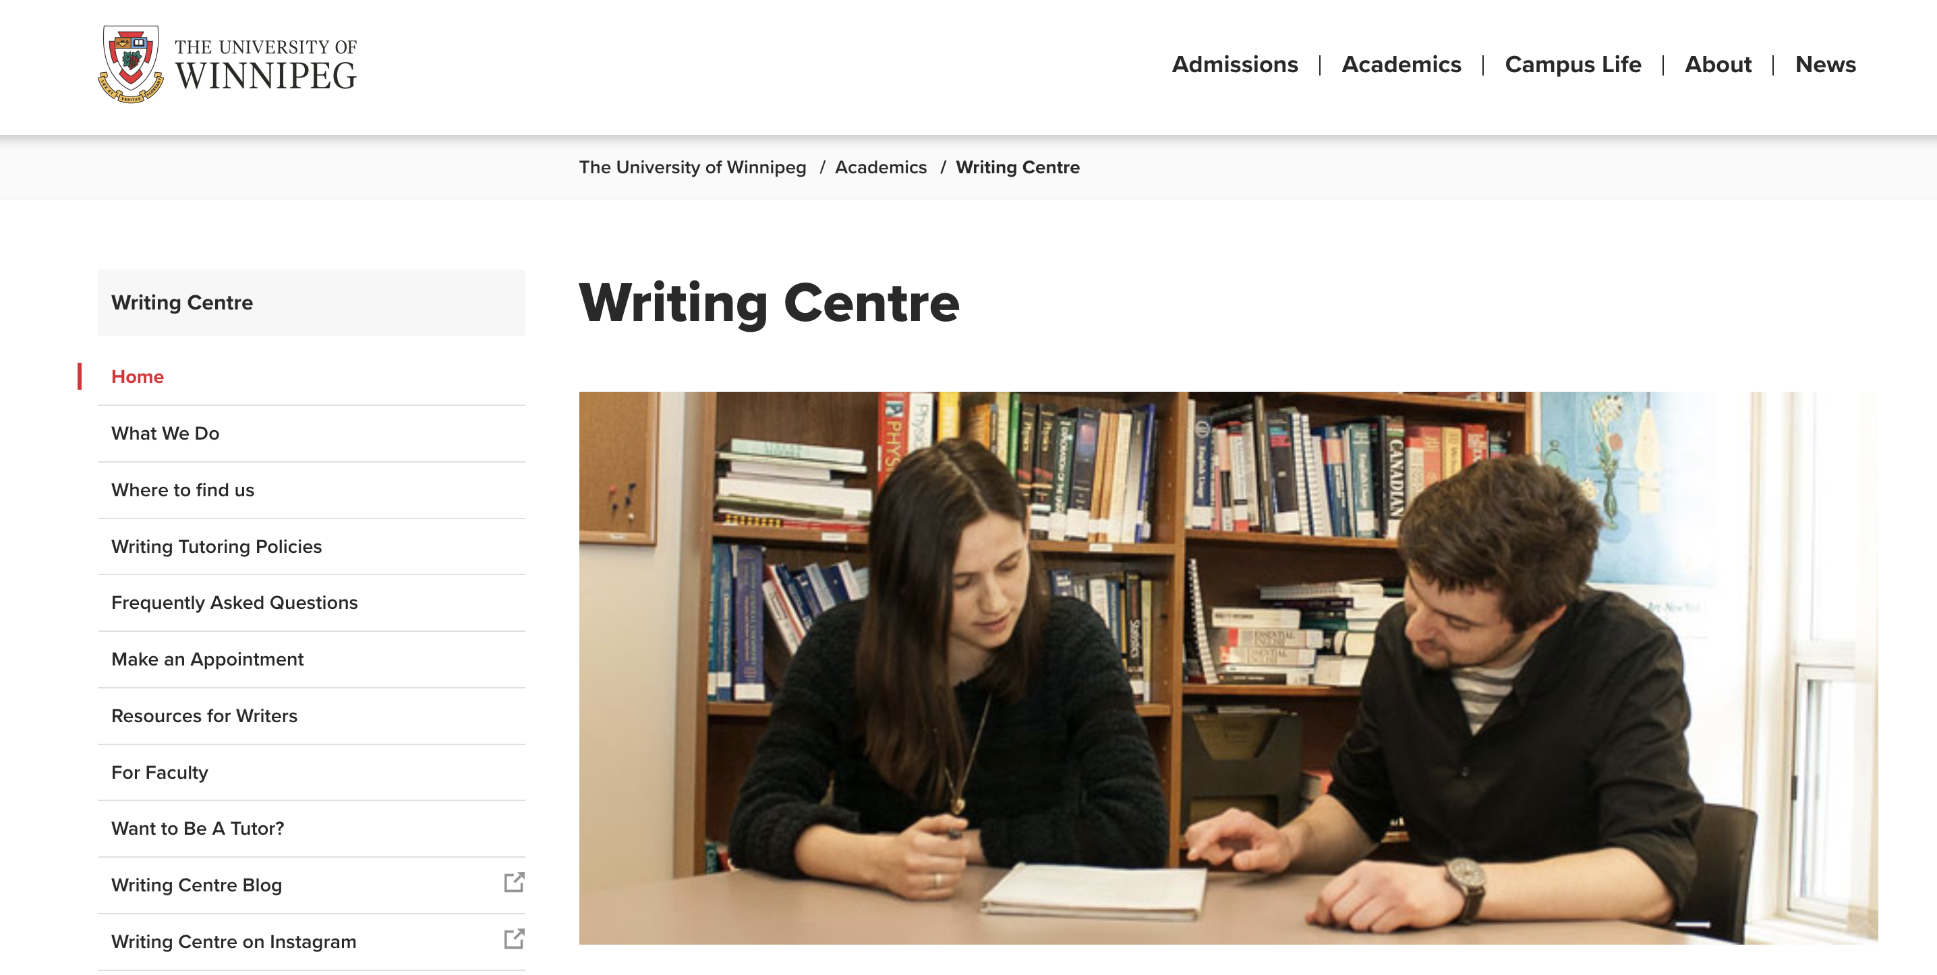
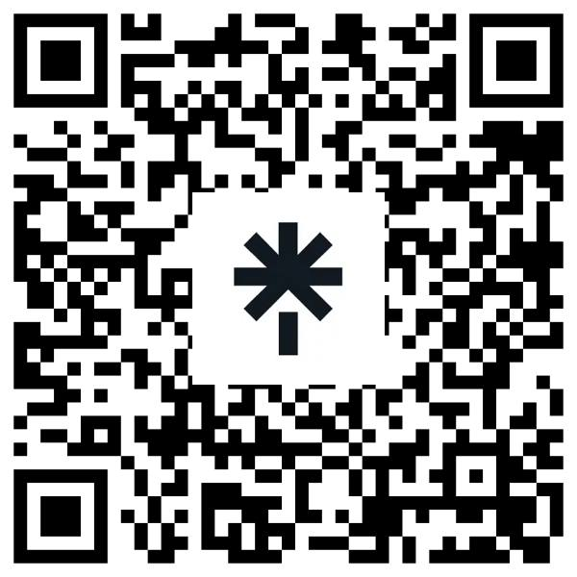
How to book an appointment
You can book online through our website or scan the QR code

Slide 5
How to find us
There are two ways to get to the Writing Centre (3rd floor Graham Hall, 3G10)
Take the elevator across from the first-floor cafeteria up to the third floor. Walk down the hallway and turn to the left!
Take the escalators up to the third floor. Turn left after you pass the Dean’s Office and follow the brightly-coloured corridor towards the Duckworth Athletic Centre.
At the end of the hallway before the overpass, turn left (signs for Graham Hall)
Turn left down that hallway and go through the door.

